Slide 1
Traveler Sales Man Problem
Presented by:
Luke Clarke
Juan Resusta

Slide 2

What Is The Traveler Sales Man Problem?
N!
41! = 3.3452527e + 49

Slide 3
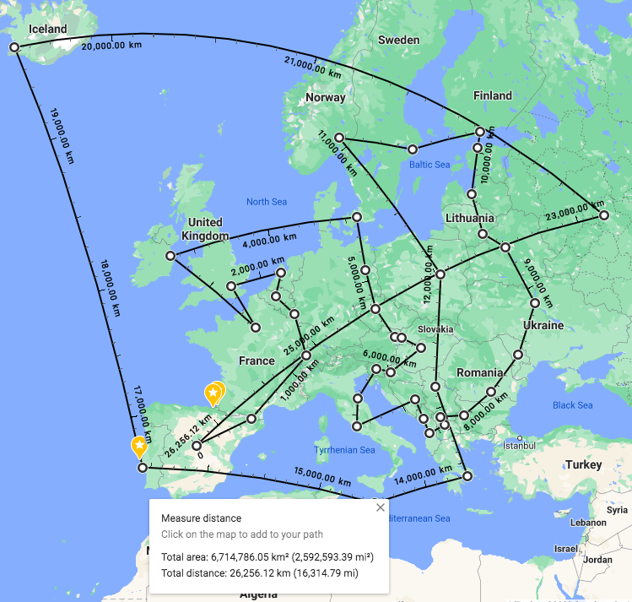
Our First Approach
Results:
Starting From Spain, Madrid: 26,289 Km
I

Slide 4
Insight
It’s A Circle!

Slide 5
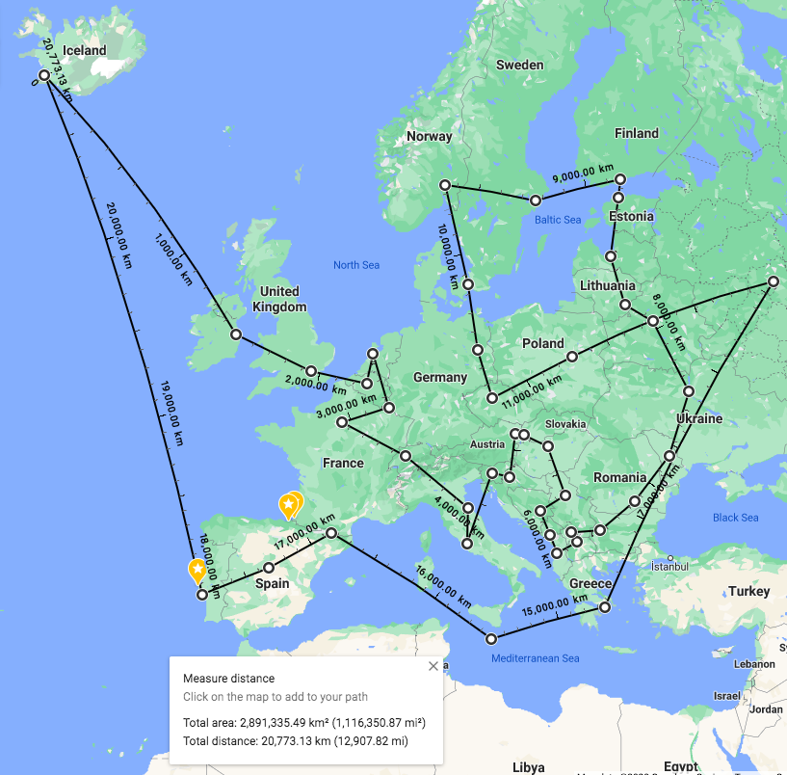
Our Second Approach
Results:
Starting From Reykjavik, Iceland: 20,801 Km

Slide 6

Experience With GitHub?

